Slide 1
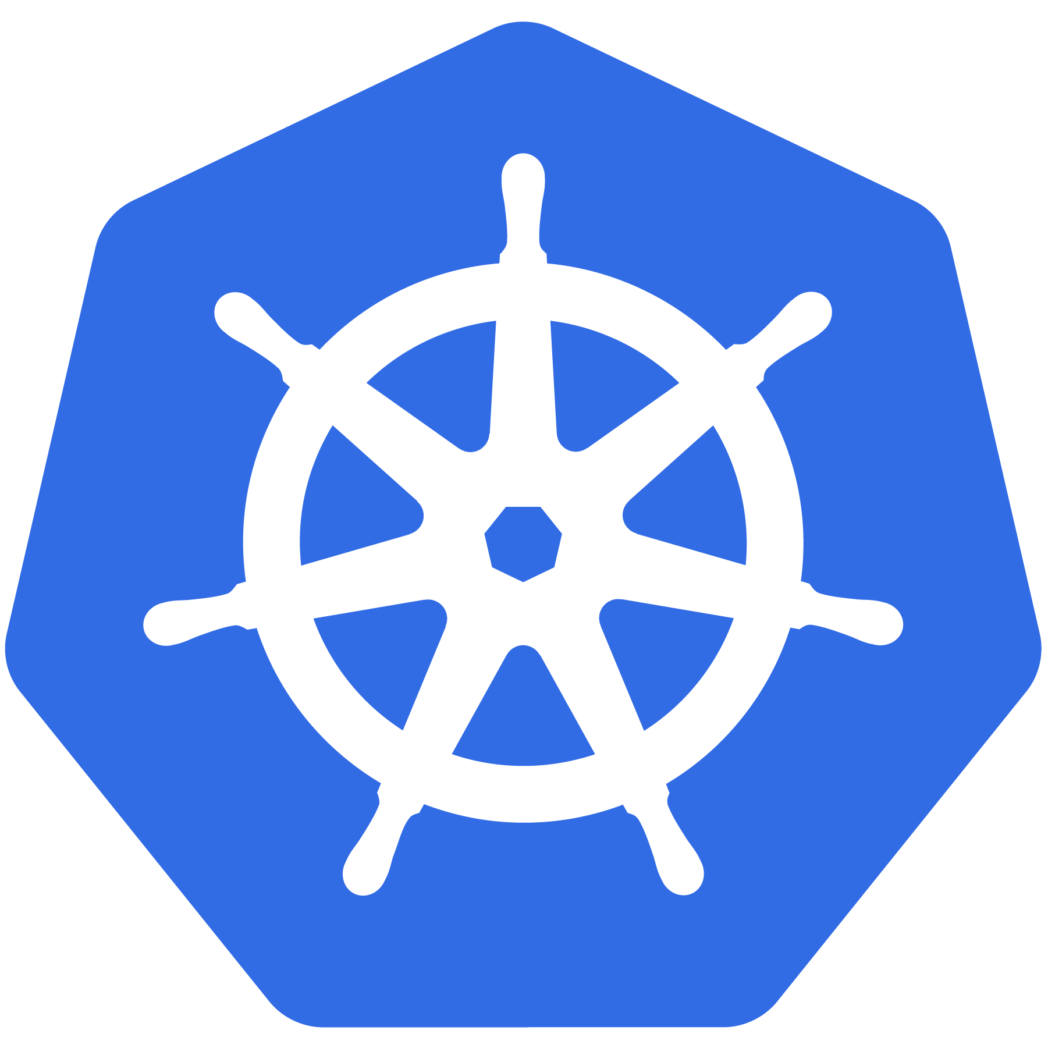
Kubernetes
Introduction to Core Objects
& Workloads

Slide 2
Agenda
kubectl
Core Objects
Namespaces
Pods..
Workloads
Deployments
StatefulSet
DaemonSet..
Services

Slide 3
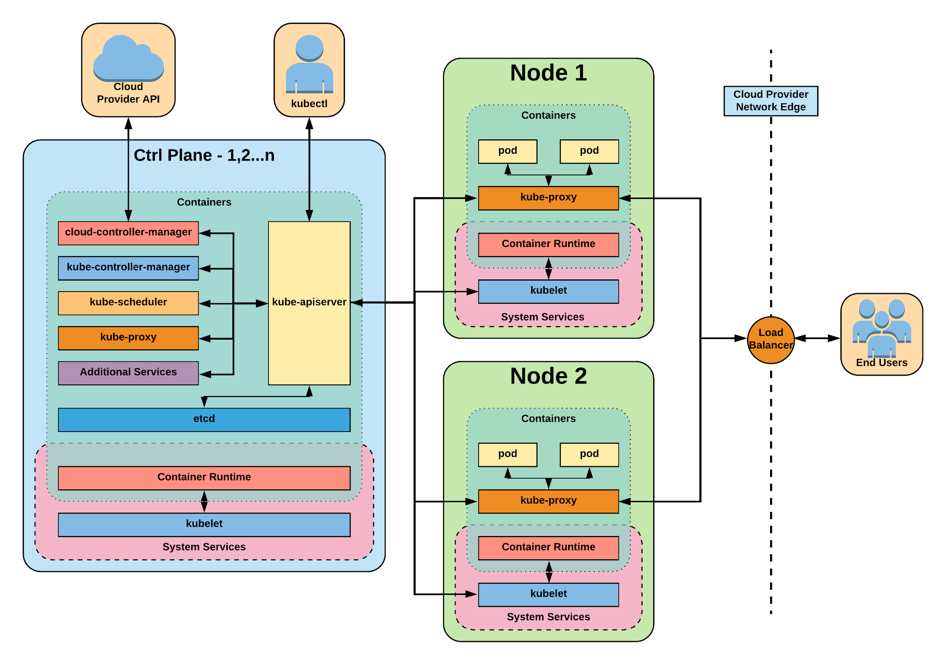

Slide 4
kubectl
Command line tool for controlling Kubernetes clusters
kubectl [command] [TYPE] [NAME] [flags]
kubectl create -f pod.yaml

Slide 5
Namespaces
Pods
Labels
Selectors
Services
Core
Objects and API
Concepts and Resources
Notes:
Kubernetes objects are persistent entities in the Kubernetes system. Kubernetes uses these entities to represent the state of your cluster. Specifically, they can describe:
What containerized applications are running (and on which nodes)
The resources available to those applications
The policies around how those applications behave, such as restart policies, upgrades, and fault-tolerance

Slide 6
Namespaces
Namespaces are a logical cluster or environment, and are the primary method of partitioning a cluster or scoping access.
apiVersion: v1
kind: Namespace
metadata:
name: prod
labels:
app: MyBigWebApp
$ kubectl get ns --show-labels
NAME STATUS AGE LABELS
default Active 11h <none>
kube-public Active 11h <none>
kube-system Active 11h <none>
prod Active 6s app=MyBigWebApp
Notes:
Think like a scope or even a subdomain
This is a very similar concept to namespaces in programming. In fact it is the same, just for application architecture.

Slide 7
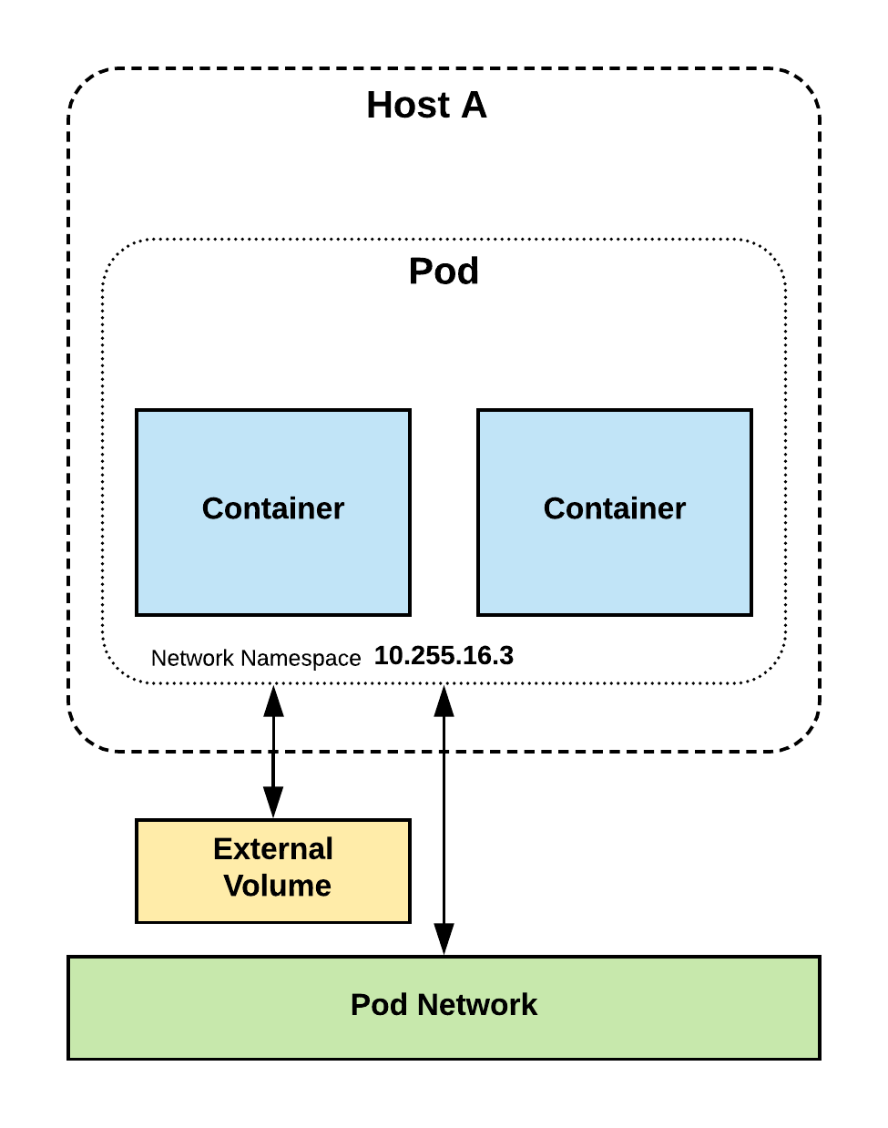
Pods
Atomic unit or smallest “unit of work”of Kubernetes.
Pods are one or MORE containers that share volumes, a network namespace, and are a part of a single context.

Slide 8
Pod Examples
apiVersion: v1
kind: Pod
metadata:
name: pod-example
spec:
containers:
- name: nginx
image: nginx:stable-alpine
ports:
- containerPort: 80
apiVersion: v1
kind: Pod
metadata:
name: redis-django
spec:
containers:
- name: key-value-store
image: redis
ports:
- containerPort: 6379
- name: frontend
image: django
ports:
- containerPort: 8000
Notes:
Discuss sidecar pattern
This is a good example of a pod having multiple containers

Slide 9
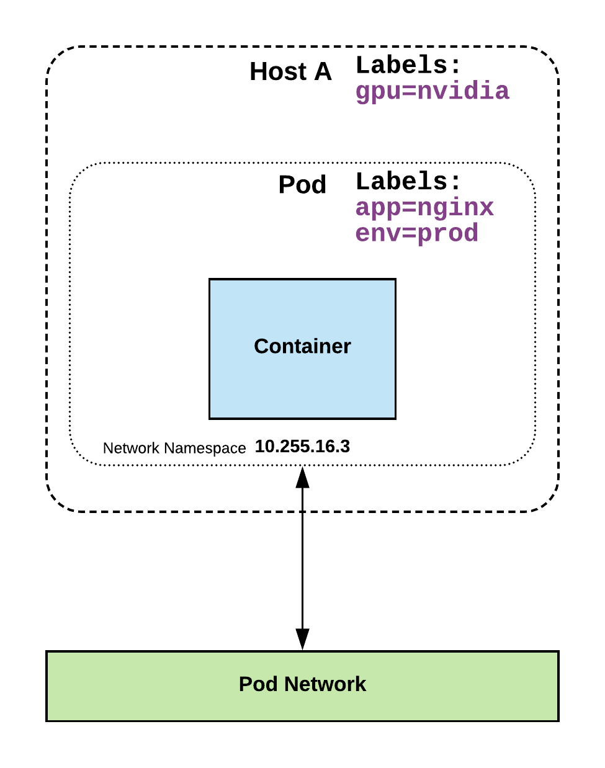
Labels
key-value pairs that are used to identify, describe and group together related sets of objects or resources.
NOT characteristic of uniqueness.
* https://kubernetes.io/docs/concepts/overview/working-with-objects/labels/#syntax-and-character-set

Slide 10
Selectors
Selectors use labels to filter or select objects, and are used throughout Kubernetes.
apiVersion: v1
kind: Pod
metadata:
name: pod-label-example
labels: app: nginx env: prod
spec:
containers:
- name: nginx
image: nginx:stable-alpine
ports:
- containerPort: 80 nodeSelector:
gpu: nvidia
Notes:
Selectors allow you to create rules based on your labels
NO ‘hard links’ to things, everything is done through labels and selectors

Slide 11
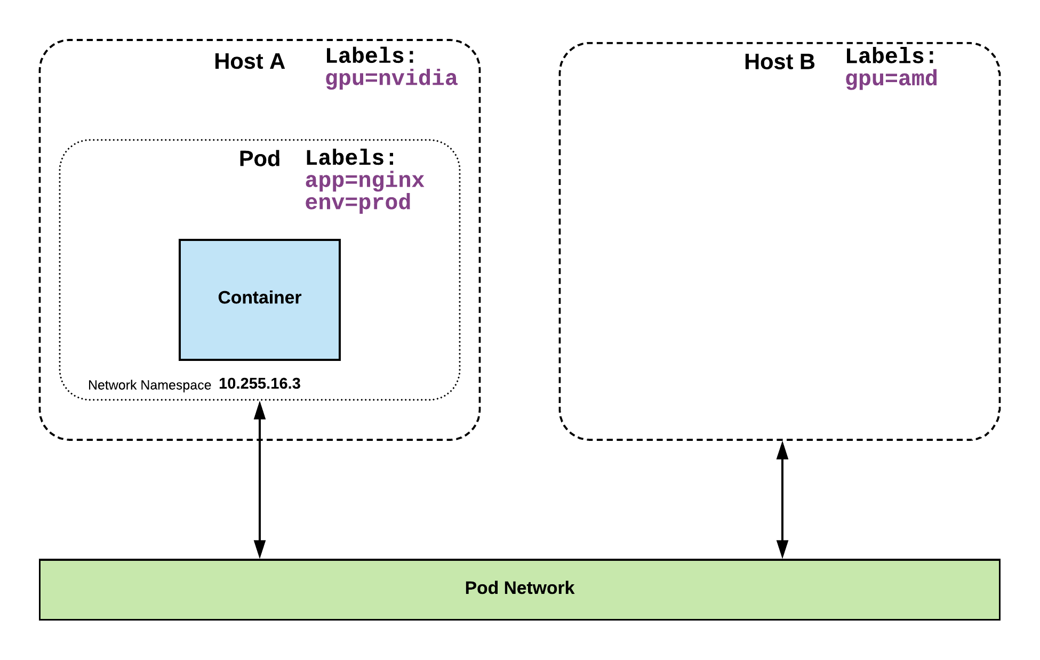
Selector Example
apiVersion: v1
kind: Pod
metadata:
name: pod-label-example
labels: app: nginx env: prod
spec:
containers:
- name: nginx
image: nginx:stable-alpine
ports:
- containerPort: 80 nodeSelector:
gpu: nvidia

Slide 12
ReplicaSet
Deployment
DaemonSet
StatefulSet
Job
CronJob
Workloads
Concepts and Resources

Slide 13
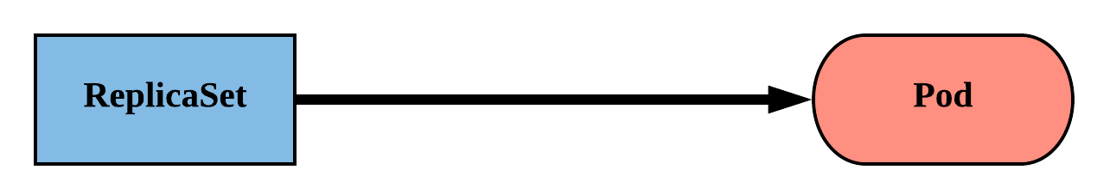
ReplicaSet
Primary method of managing pod replicas and their lifecycle.
Includes their scheduling, scaling, and deletion.
Their job is simple: Always ensure the desired number of pods are running.
Notes:
ReplicaSets are “dumb”
They strive to ensure the number of pods you want running will stay running

Slide 14
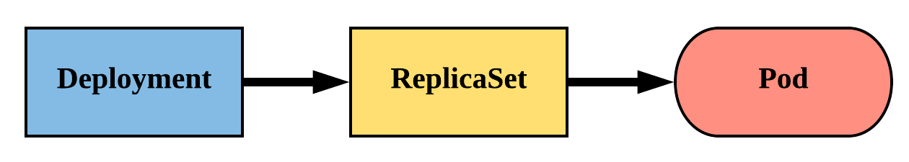
Deployment
Way of managing Pods via ReplicaSets.
Provide rollback functionality and update control.
Updates are managed through the pod-template-hash label.
Each iteration creates a unique label that is assigned to both the ReplicaSet and subsequent Pods.
Notes:
The real way we manage pods
Deployments manage replicasets which then manage pods
Rare that you manage replicasets directly because they are ‘dumb’
Offer update control and rollback functionality, gives blue/green deployment
Does this through hashing the pod template and storing that value in a label, the pod template hash
Used in replicaset name
Added to the selector and pod labels automatically
gives us a unique selector that strictly targets a revision of a pod

Slide 15
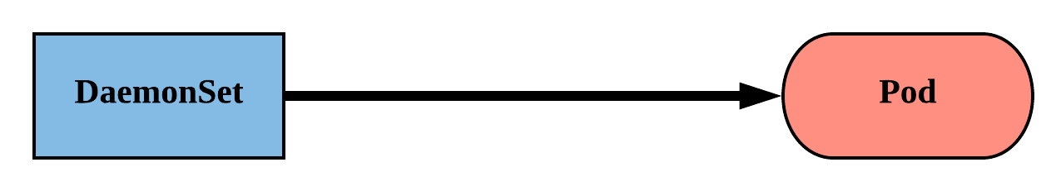
DaemonSet
Ensure that all nodes matching certain criteria will run an instance of the supplied Pod.
Are ideal for cluster wide services such as log forwarding or monitoring.
Notes:
Daemonsets schedule pods across all nodes matching certain criteria.
They work best for services like log shipping and health monitoring.
The criteria can be anything from the specific OS or Arch, or your own cluster-specific labels.

Slide 16
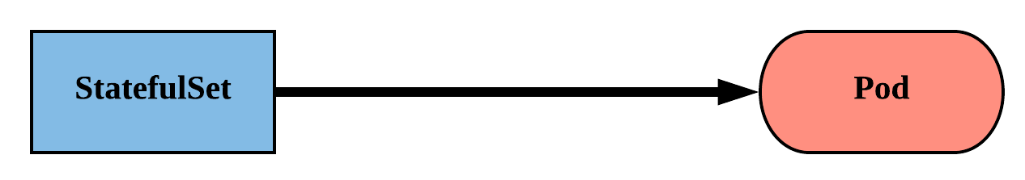
StatefulSet
Tailored to managing Pods that must persist or maintain state.
Assigned a unique ordinal name following the convention of ‘<statefulset name>-<ordinal index>’.
Useful when
Stable, unique network identifiers
Stable, persistent storage
Ordered, graceful deployment and scaling
Notes:
Tailored to apps that must persist or maintain state: namely databases
Generally these systems care a bit more about their identity, their hostname their IP etc
instead of that random string on the end of a pod name, they’ll get a predictable value
Follows the convention of statefulset name - ordinal index
ordinal index correlates to replica
Ordinal starts at 0, just like a normal array e.g. mysql-0
naming convention carries over to network identity and storage

Slide 17
Job
Ensures a pod properly runs a given task to completion
completions - specify how many pods needs to run to completion for the job to be completed
parallelism is used to say how many pods run in parallel
apiVersion: batch/v1
kind: Job
metadata:
name: pi
spec:
template:
spec:
containers:
- name: pi
image: perl
command: ["perl", "-Mbignum=bpi", "-wle", "print bpi(2000)"]
restartPolicy: Never
backoffLimit: 4

Slide 18
CronJob
An extension of the Job Controller, it provides a method of executing jobs on a cron-like schedule.
schedule: The cron schedule for the job.
successfulJobHistoryLimit: The number of successful jobs to retain.
failedJobHistoryLimit: The number of failed jobs to retain.
apiVersion: batch/v1beta1
kind: CronJob
metadata:
name: cronjob-example
spec:
schedule: "*/1 * * * *"
successfulJobsHistoryLimit: 3
failedJobsHistoryLimit: 1
jobTemplate:
spec:
completions: 4
parallelism: 2
template:
<pod template>

Slide 19
Services
Concepts and Resources
Notes:
rs,ds,j/cronjob - jeff
dep,sts - bob

Slide 20
Services
Unified method of accessing the exposed workloads of Pods.
Durable resource (unlike Pods)
static cluster-unique IP
static namespaced DNS name
apiVersion: v1
kind: Service
metadata:
name: rating-service
spec:
type: NodePort
selector:
app: rating
ports:
- port: 80
targetPort: 80
<service name>.<namespace>.svc.cluster.local
Notes:
Not ephemeral. Repeat repeat repeat.

Slide 21
Service Types
There are 3 major service types:
ClusterIP (default)
NodePort (30000-32767)
LoadBalancer

Slide 22
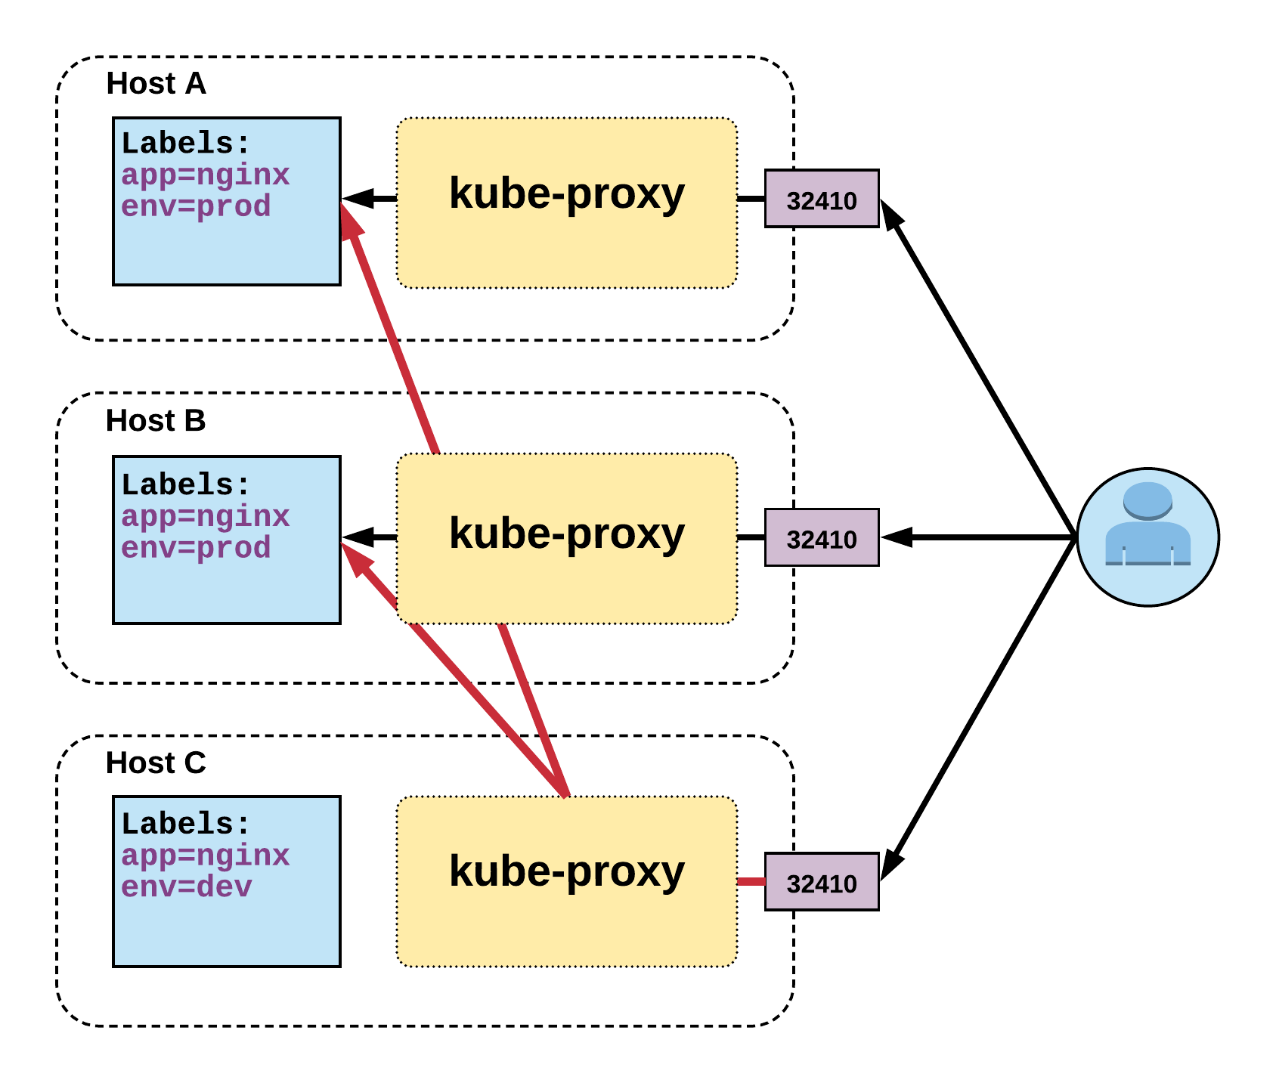
NodePort Service
Name: example-prod
Selector: app=nginx,env=prod
Type: NodePort
IP: 10.96.28.176
Port: <unset> 80/TCP
TargetPort: 80/TCP
NodePort: <unset> 32410/TCP
Endpoints: 10.255.16.3:80, 10.255.16.4:80
Notes:
User can hit any host in cluster on nodeport IP and get to service
Does introduce extra hop if hitting a host without instance of the pod

Slide 23
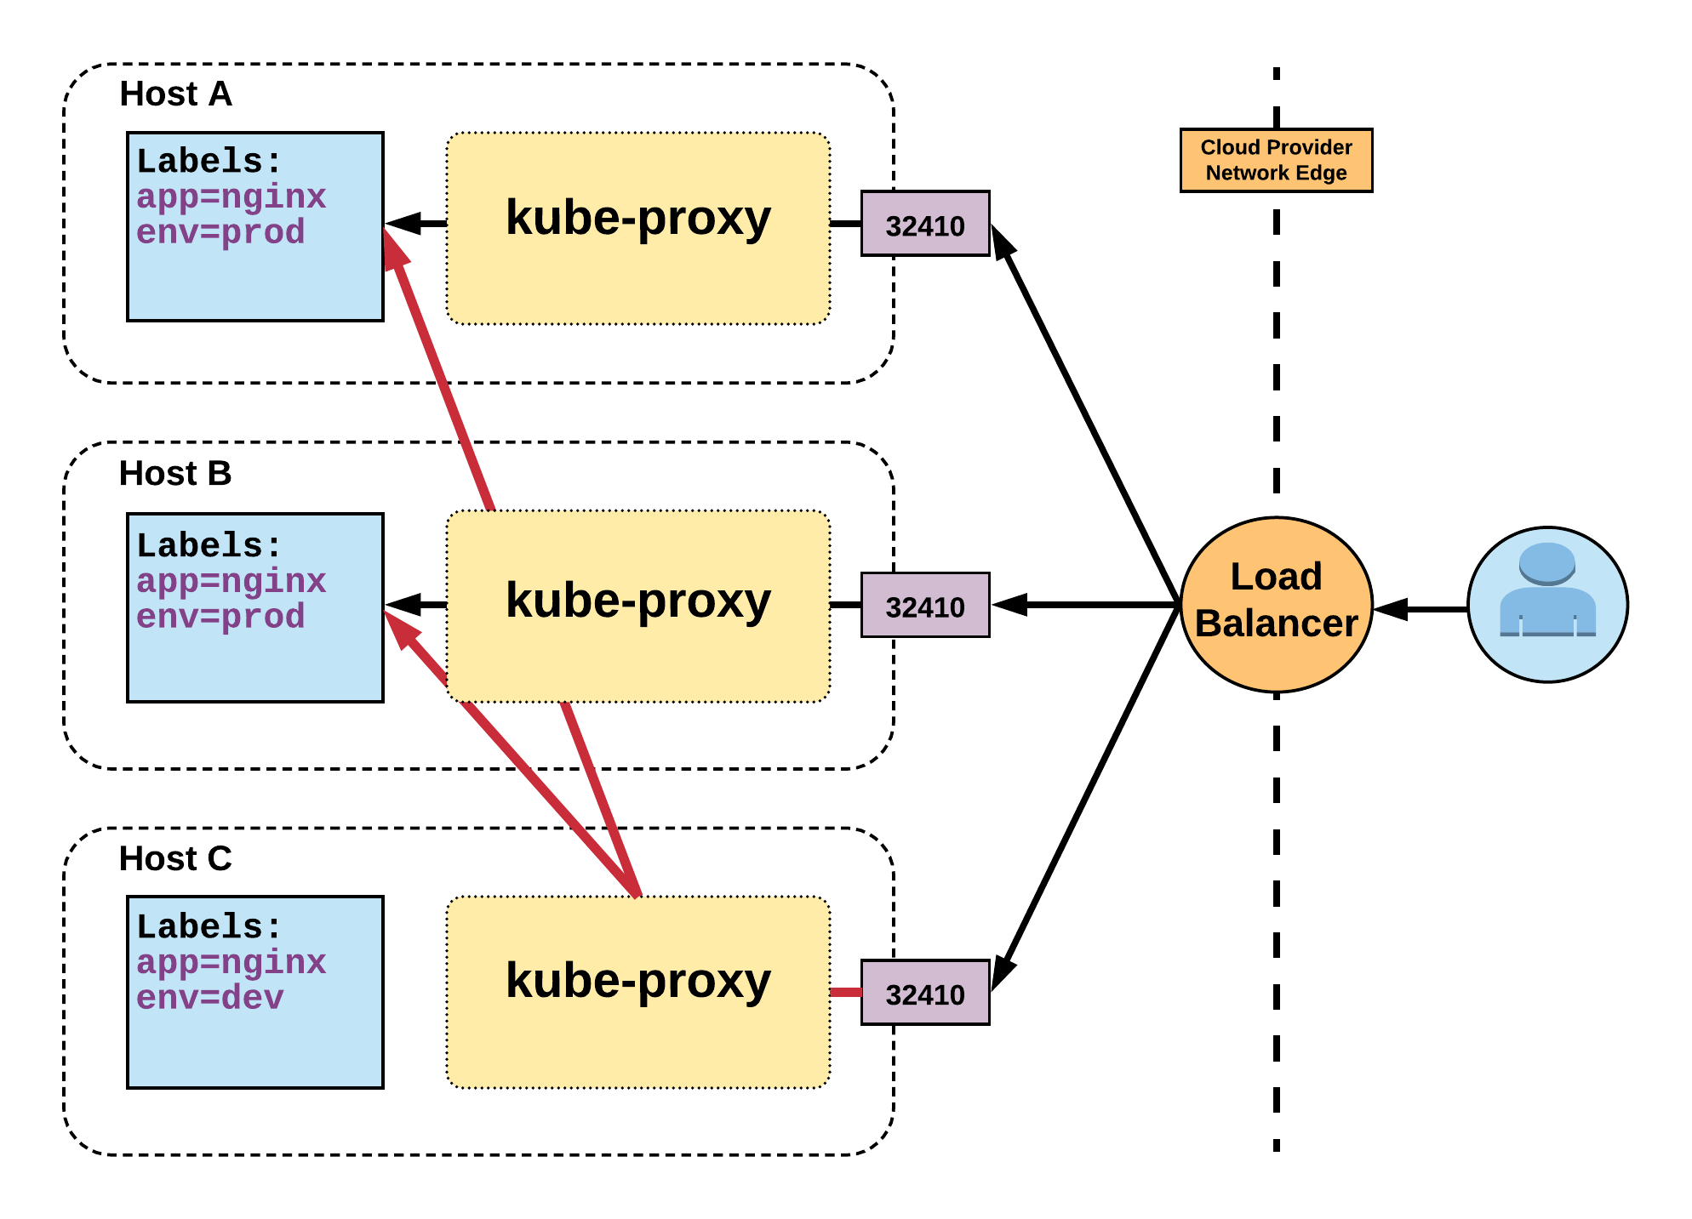
LoadBalancer Service
Name: example-prod
Selector: app=nginx,env=prod
Type: LoadBalancer
IP: 10.96.28.176
LoadBalancer Ingress: 172.17.18.43
Port: <unset> 80/TCP
TargetPort: 80/TCP
NodePort: <unset> 32410/TCP
Endpoints: 10.255.16.3:80, 10.255.16.4:80
Notes:
Gets external IP from provider
There are settings to remove nodes that are not running an instance of the pod. To remove extra hop.

Slide 24
Thank You

